Slide 1
DBMS Introduction

Slide 2
This presentation
uses of DB systems
DB environment
DB structure
Codd’s rules
current common RDBMs implementations

Slide 3
Why Do I Care About DBs
99% of my projects at work include a DB
how many school projects?

Slide 4
Uses of Databases
Used in large and small organizations. Examples
Consumer websites and customer service websites
Online banking
Credit card companies
Supermarkets and retail stores
Airline reservations
Medical records and billing
Employment records
School records
Bibliographic Databases
Advanced applications-Geographic Information Systems, software development, scientific research, Decision Support Systems, Customer Relations Management, search engines

Slide 5
The Integrated Database Environment
Database
Large repository of data
Contains different record types
Contains metadata -“knows” about structure and relationships in data
Managed by database administrator – DBA
DBMS, Database Management System
Controls access to database
Has facilities to
Set up database structure
Load the data
Retrieve requested data and format it for users
Hide sensitive data
Accept and perform updates
Handle concurrency
Perform backup and recovery … and many other functions…
Applications

Slide 6
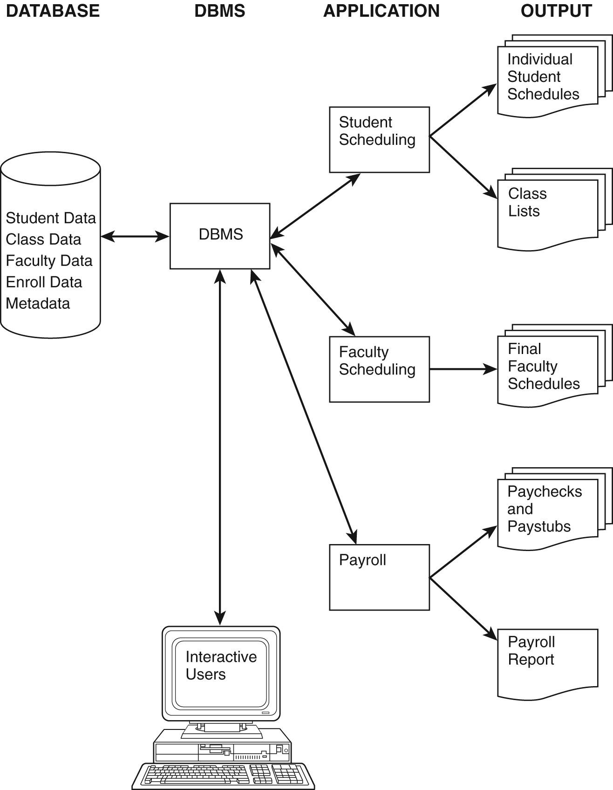

Slide 7
Example of Integrated Database Environment
University database
DBMS - may be Access, Oracle, DB2,…
Users may be individuals on workstations (interactive users) or application programs
Both users and applications go through DBMS
Applications produce standard output, such as reports

Slide 8
Database Structure

Slide 9
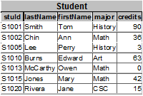

Slide 10
Table Design
all data stored in tables
one entity per table (usually)
data as well as relationships
rows
each rows contains a single record
cell
intersection of a row and column
columns
each column contains an attribute of the entity

Slide 11
A Sample Database
Simple University database
Keeps information about
Students
Classes-links Faculty to their classes
Enrollment-links students to their classes
Data represented as tables
Each row of Student table represents one student, of Faculty one faculty member, of Class one class
Each row of Enroll represents relationship between one student and one class

Slide 12
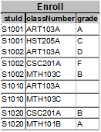
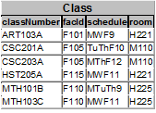

Slide 13
Table Design cont’d
primary key
uniquely identifies the row
composite primary key – multiple columns, single key
foreign key
a key that references a primary key in a different table

Slide 14
Codd’s Rules

Slide 15
Relational DB – Codd’s Rules
basis for a relational model, which lead to the development of RDBMS
The rules are:
DBMS must be able to manage DB via relational capabilities
All information is represented in a tabular format
Guaranteed Access – every value is guaranteed to be accessible by a combination of the table name, the primary key and the column name
Null value support – DBMS supports null value, which is distinct from default values and independent of any domain
Active, online relational catalogue – description of the DB and its contents is represented in a tabular format, and can be queried

Slide 16
Relational DB – Codd’s Rules cont’d
Comprehensive data sublanguage – languages must have a well-defined syntax; supports data definition, manipulation, integrity rules, authorization and transactions
View updating – all views that are theoretically updatable, can be updated
Set-level insertion, updating and deletion – DBMS supports retrieval of sets as well as insertion, updating and deletion
Physical data independence – application programs are unaffected when physical access methods change

Slide 17
Relational DB – Codd’s Rules cont’d
Logical data independence – application programs are logically unaffected when changes are made to table structures
Integrity independence – DB language must be capable of defining integrity rules. These will be stored in the online catalogue and cannot be bypassed.
Distribution independence – application programs are logically unaffected when data is first distributed (or redistributed).
Nonsubversion – it must be impossible to bypass the integrity rules by using lower level languages.

Slide 18
Databases Today

Slide 19
DBs Today
relational / OO models
using SQL (Structured Query Language)
using DBMS (DataBase Management System)
a software “package”
manages DBs
manages data storage within
can run on multiple OS
basic supported features – supports data modeling, query language, access controls, transactions
some support more advanced features – backup, replication, encryption

Slide 20
Most Common RDBMS
Oracle
Oracle
C/C++
OS - multiple
used by large corporations
sells different packages
inline SQL, but also management tools
e.g. Enterprise Edition -> $40 – 80K/processor (2010)
MySQL
MySQL AB (Subsidiary of Oracle)
C/C++
OS – multiple
source code available under GNU General Public License
open source
multiple flavors
used by free/open source projects
also used by Google, Wikipedia
Oracle seems to be cutting back support (change sets, documentation)

Slide 21
Most Common RDBMS cont’ed
SQL Server
Microsoft
C/C++/C#
OS – Windows
used in this class
many options, including SQL CE, Reporting Services
incorporated into Visual Studio and other MS tools
e.g. Enterprise Edition -> $20K/processor (2010)

Slide 22
This presentation
uses of DB systems
DB environment
DB structure
Codd’s rules
current common RDBMs implementations

